Slide 1
Ch – 3 Words and Transducers

Slide 2
Chapter 3. Words and Transducers
From: Chapter 3 of An Introduction to Natural Language Processing, Computational Linguistics, and Speech Recognition, by Daniel Jurafsky and James H. Martin

Slide 3
Words and Transducers
Background: Tasks related to morphological parsing:
Morphological parsing
Stemming
Lemmatization
Tokenization
Minimum edit distance algorithm

Slide 4
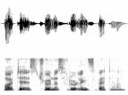
1.1 Knowledge in Speech and Language Processing- 6 Categories of Linguistic Knowledge
Pragmatics
Acoustic/
Phonetic
Syntax
Semantics
sound
waves
words
parse
trees
literal
meaning
meaning
(contextualized)

Slide 5
Background
Parsing vs. Morphological parsing
Parsing: taking an input and producing some sort of linguistic structure for it.
very broad usage throughout this book
includes many kinds of structures that might be produced;
morphological, syntactic, semantic, discourse; in the form of a string, or a tree, or a network.
Morphological parsing:
The problem of recognizing that a word (like foxes) breaks down into component morphemes (fox and -es) and building a structured representation of this fact is called morphological parsing.
Morphology and FSTs

Slide 6
Background
Stemming:
In information retrieval and web search (IR), we might want to map from foxes to fox;
but might not need to also know that foxes is plural.
Just stripping off such word endings is called stemming in IR.
Porter stemmer : a simple stemming algorithm.
Morphology and FSTs

Slide 7
Background
Lemmatization:
For other speech and language processing tasks, we need to know that two words have a similar root, despite their surface differences.
For example the words sang, sung, and sings are all forms of the verb sing.
The word sing is called the common lemma of these words, and mapping from all of these to sing is called lemmatization
Morphology and FSTs

Slide 8
Background
Tokenization or word segmentation :
Tokenization or word segmentation is the task of separating out (tokenizing) words from running text.
In English, words are often separated from each other by blanks (whites-pace),
but whitespace is not always sufficient;
Ex: New York and rock 'n' roll are individual words despite the fact that they contain spaces (space does not indicate a new word here)
for many applications we need to separate I'm into the two words I and am ( no space indicates a new word here)
Morphology and FSTs

Slide 9
Background
Minimum edit distance algorithm :
For many applications we need to know how similar two words are ortho-graphically.
Morphological parsing is one method for computing this similarity
but another is to just compare the strings of letters to see how similar they are.
A common way of doing this is with the minimum edit distance algorithm, which is important throughout NLP.
We'll use this algorithm and see how it can be used in spell-checking.
Morphology and FSTs

Slide 10
3.1 Survey of (Mostly) English Morphology
Morphology is the study of the way words are built up from smaller meaning-bearing units, morphemes.
A morpheme is often defined as the minimal meaning-bearing unit in a language.
So for example the word fox consists of a single morpheme (the mor-pheme fox) while the word cats consists of two: the morpheme cat and the morpheme -s
Two broad classes of morphemes:
  The stems: the “main” morpheme of the word, supplying the main meaning,
  The affixes: add “additional” meaning of various kinds.

Slide 11
3.1 Survey of (Mostly) English Morphology
Affixes are further divided into prefixes, suffixes, infixes, and circumfixes.
  Suffix: eat-s
  Prefix: un-buckle
  Circumfix: ge-sag-t (said) sagen (to say) (in German)
  Infix: hingi (borrow) humingi (the agent of an action) )in Philippine language Tagalog)

Slide 12
3.1 Survey of (Mostly) English Morphology
Pre-fixes precede the stem,
suffixes follow the stem,
circumfixes do both, and
infixes are inserted inside the stem.
Ex: the word eats is composed of a stem eat and the suffix -s.
The word unbuckle is composed of a stem buckle and the prefix un-.
English does not have any good examples of circumfixes
WHY?

Slide 13
3.1 Survey of (Mostly) English Morphology
Circumfixes in English
NOTE: These are not circumfixes
  un-believ-ably, un-conscious-ness, un-believ-able, un-like-ly.
un-conscious-ness
We can have word “unconscious” by removing “ness” and also can have consciousness by removing “un” .

Slide 14
3.1 Survey of (Mostly) English Morphology
Circumfixes in English
There are affixes that are made of two different parts, and if you do not have both of those sections, we have not really got the whole morpheme.
Both parts are essential and they sandwich the root. EX:
  en-live-n
  em-bold-en
These examples are the same circumfix, starting with en- and ending with -en, with the root going in the middle.
We can tell this is a circumfix because :
  we can not take off either half and still have it keep the same meaning, or even be a word at all
  In (2), both halves are really required: it can not be embold, nor can it come up as bolden.
  Both are not words in English, and they do not have the right meaning. They need both halves.

Slide 15
3.1 Survey of (Mostly) English Morphology
Give a word that has more than one affix?
Ex1: the word rewrites has
the prefix re-,
the stem write,
the suffix -s.
Ex2: the word unbelievably has
a stem (believe) plus three affixes ( un-, -able, and -ly).
While English does not have more than four or five affixes,
languages like Turkish can have words with nine or ten affixes

Slide 16
3.1 Survey of (Mostly) English Morphology
There are many ways to combine morphemes to create words.
Four of these methods are common and play important roles in speech and language processing:
inflection,
derivation,
compounding, and
cliticization
Morphology and FSTs

Slide 17
3.1 Survey of (Mostly) English Morphology
Inflection is the combination of a word stem with a grammatical morpheme, usually resulting in a word of the same class as the original stem, and usually filling some syntactic function like agreement.
Ex: English has the inflectional morpheme -s for marking the plural on nouns, and
the inflectional morpheme -ed for marking the past tense on verbs.
Morphology and FSTs

Slide 18
3.1 Survey of (Mostly) English Morphology
Derivation is the combination of a word stem with a grammatical morpheme, usually resulting in a word of a different class, often with a meaning hard to predict exactly.
For example the verb computerize can take the derivational suffix -ation to produce the noun computerization.
Derivation refers to an affix that indicates a change of grammatical category (ie. part of speech).
Morphology and FSTs

Slide 19
3.1 Survey of (Mostly) English Morphology
Compounding is the combination of mul-tiple word stems together.
For example the noun doghouse is the concatenation of the morpheme dog with the morpheme house. Ex: baseball, desktop, homework
cliticization is the combination of a word stem with a clitic.
A clitic is a morpheme that acts syntactically like a word, but is reduced in form and attached (phonologically and sometimes orthographically) to another word.
For example the English morpheme 've in the word I've is a clitic, as is the French definite article l' in the word l'opera.
Morphology and FSTs

Slide 20
3.1 Survey of (Mostly) English Morphology
3.1.1 Inflectional Morphology
Morphology and FSTs

Slide 21
3.1.1 Inflectional Morphology
English has a relatively simple inflectional system;
only nouns, verbs, and sometimes adjectives can be inflected,
and the number of possible inflectional affixes is quite small.
English nouns have only two kinds of inflection: an affix that marks plural and an affix that marks possessive.
For example, many (but not all) English nouns can either appear in the bare stem or singular form, or take a plural suffix.
Morphology and FSTs

Slide 22
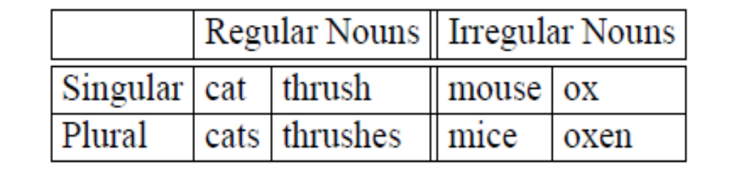
3.1.1 Inflectional Morphology
Here are examples of the regular plural suffix -s (also spelled -es), and irregular plurals:
Morphology and FSTs

Slide 23
3.1.1 Inflectional Morphology
Regular nouns:
  While the regular plural is spelled -s after most nouns,
  it is spelled -es after words ending in -s (ibis/ibises), -z (waltz/waltzes), -sh (thrush/thrushes), -ch (finch/finches ), and sometimes -x (box/boxes).
  Nouns ending in -y preceded by a consonant change the -y to -i (butterfly/butterflies).
The possessive suffix is realized by
  apostrophe + -s for
    regular singular nouns (llama's) and
    plural nouns not ending in -s (children's) and
  often by a lone apostrophe
    after regular plural nouns (llamas') and
    some names ending in -s or -z (Euripides' comedies).

Slide 24
3.1.1 Inflectional Morphology
Types of verbs and verbal Inflection
English has three kinds of verbs;
main verbs, (eat, sleep, teach),
modal verbs (can, will, should, may, must, ought to), and
primary verbs (be, have, do)
Nominal (of, relating to, or being a noun) inflection vs. Verbal inflection
English verbal inflection is more complicated than nominal inflection
In this chapter we will be concerned with the main and primary verbs, because it is these that have inflectional endings.
Morphology and FSTs

Slide 25
3.1.1 Inflectional Morphology
Regular verbs
Of these verbs a large class are regular, that is to say all verbs of this class have the same endings marking the same functions.
These regular verbs (e.g. walk, or inspect) have four morphological forms, as follow:
Morphological Form Classes | Regularly Inflected Verbs
stem | walk | merge | try | map
-s form | walks | merges | tries | maps
-ing participle | walking | merging | trying | mapping
Past form or -ed participle | walked | merged | tried | mapped
Morphology and FSTs

Slide 26
3.1.1 Inflectional Morphology
Regular verbs
Note: These verbs are called regular because by knowing the stem we can predict the other forms by adding one of three predictable endings and making some regular spelling changes
These regular verbs are significant in the morphology of English
  first because they cover a majority of the verbs, and
  second because the regular class is productive.
  a productive class is one that automatically includes any new words that enter the language.
  Ex: the recently-created verb fax (My mom faxed me the note) takes the regular endings -ed, -ing, -es. (Note that the -s form is spelled faxes rather than faxs; )

Slide 27
3.1.1 Inflectional Morphology
Irregular verbs
The irregular verbs are those that have some more or less idiosyncratic forms (unique) of inflection.
Irregular verbs in English often have five different forms, but can have as many as eight (e.g., the verb be) or as few as three (e.g. cut or hit).
Irregular verbs constitutes a smaller class of verbs there are only about 250 irregular verbs

Slide 28
3.1.1 Inflectional Morphology
Irregular verbs
The table below shows some sample irregular forms.
Note that an irregular verb can inflect in the past form (also called the preterite) by changing its vowel (eat/ate), or its vowel and some consonants (catch/caught), or with no change at all (cut/cut).
Morphological Form Classes |  | Irregularly Inflected Verbs
stem |  | eat | catch | cut
-s form |  | eats | catches | cuts
-ing participle |  | eating | catching | cutting
Past form (Preterite) |  | ate | caught | cut
-ed/-en participle |  | eaten | caught | cut
Morphology and FSTs

Slide 29
3.1.1 Inflectional Morphology
Verbal Inflection:
The -s form is used in the “habitual present” form to distinguish the third-person singular ending (She jogs every Tuesday) from the other choices of person and number (I/you/we/they jog every Tuesday).
The stem form is used in the infinitive form, and also after certain other verbs (I'd rather walk home, I want to walk home).
The -ing participle is used in the progressive construction to mark present or ongoing activity (It is raining), or when the verb is treated as a noun; this kind of nominal use of a verb is called a gerund use: Fishing is fine if you live near water.
The -ed/-en participle is used in the perfect construction (He's eaten lunch already) or the passive construction (The verdict was overturned yesterday).

Slide 30
3.1.1 Inflectional Morphology
Verbal Inflection:
a number of regular spelling changes occur at the morpheme boundaries.
Ex: a single consonant letter is doubled before adding the -ing and -ed suffixes ( beg/begging/begged).
If the final letter is “c”, the doubling is spelled “ck” ( picnic/picnicking/picnicked).
If the base ends in a silent -e, it is deleted before adding -ing and -ed (merge/merging/merged).
Just as for nouns, the -s ending is spelled -es after verb stems ending in -s (toss/tosses) , -z, (waltz/waltzes) -sh, (wash/washes) -ch, (catch/catches) and sometimes -x (tax/taxes).
Also like nouns, verbs ending in -y preceded by a consonant change the -y to -i (try/tries).

Slide 31
Morphological forms of irregular verbs
  Have five different forms
  But can have as many as eight (verb ‘be’)
  Or as few as three (verb ‘cut’ )
stem | eat | catch | cut
-s form | eats | catches | cuts
-ing principle | eating | catching | cutting
Past form | ate | caught | cut
–ed participle | eaten | caught | cut
the simple form: be
the -ing participle form: being
the past participle: been
the first person singular present tense form: am
the third person present tense (-s) form: is
the plural present tense form: are
the singular past tense form: was
the plural past tense form: were

Slide 32
8 forms of verb and 5 forms of verb
Irregular verbs:
The verb to be uses 8 words to express the standard forms
Form | To Be
Infinitive | 1. be
Present Tense | 2. am 3. is 4. are
Past Tense | 5. was 6. were
Past Participle | 7. been
Present Participle | 8. being
The verb to see uses 5 words to express the standard forms
Form | To See
Infinitive | 1. see
Present Tense | 1. see (same as infinitive) 2. sees (third-person singular)
Past Tense | 3. saw
Past Participle | 4. seen
Present Participle | 5. seeing
Morphology and FSTs

Slide 33
3.1.2 Derivational Morphology
Inflection vs. Derivation
English inflection is relatively simple compared to other languages
derivation in English is quite complex.
Derivation
derivation is the combination of a word stem with a grammatical morpheme, usually resulting in a word of a different class, often with a meaning hard to predict exactly.
A very common kind of derivation in English is the formation of new nouns, often from verbs or adjectives.
This process is called nominalization.
Morphology and FSTs

Slide 34
3.1.2 Derivational Morphology
Nominalization
Ex: the suffix -ation produces nouns from verbs ending often in the suffix -ize (computerize → computerization).
Here are examples of some particularly productive English nominalizing suffixes.
Suffix | Base Verb/Adjective | Derived Noun
-ation | computerize (V)
-ee | appoint (V)
-er | kill (V)
-ness | fuzzy (A)
Morphology and FSTs

Slide 35
3.1.2 Derivational Morphology
Nominalization
Ex: the suffix -ation produces nouns from verbs ending often in the suffix -ize (computerize → computerization).
Here are examples of some particularly productive English nominalizing suffixes.
Suffix | Base Verb/Adjective | Derived Noun
-ation | computerize (V) | computerization
-ee | appoint (V) | appointee
-er | kill (V) | killer
-ness | fuzzy (A) | fuzziness
Morphology and FSTs
Note: Also -ment , -ism gives noun forms

Slide 36
3.1 Survey of (Mostly) English Morphology
Derivational Morphology
  Adjectives derived from nouns or verbs
Suffix | Base Noun/Verb | Derived Adjective
-al | computation (N) | computational
-able | embrace (V) | embraceable
-less | clue (N) | clueless
Note: computation – noun
computational and computative - adjective
computatively - adverb

Slide 37
3.1 Survey of (Mostly) English Morphology
Derivational Morphology
Derivation in English is more complex than inflection because
  Generally less productive
    A nominalizing affix like –ation can not be added to absolutely every verb - eatation(*)
  There are subtle and complex meaning differences among nominalizing suffixes.
  Ex: sincerity has a subtle difference in meaning from sincereness.
  Sincereness - genuine
  Sincerity – seriousness + honesty

Slide 38
Summary: Inflection vs. Derivation
Inflection The English plural suffix -s in book-s is an inflectional suffix because it distinguishes the plural form books from the singular form book.
books and book are different grammatical forms of the same morpheme.
Derivation refers to an affix that indicates a change of grammatical category (ie. part of speech).
Example: the word person-al.
personal belongs to a different word class (i.e. it is an adjective) from person (which is a noun).
A derivational suffix like "-ly"can transform an adjective into an adverb, the suffix "-ment" is often used to produce a noun.
Morphology and FSTs

Slide 39
Summary: Inflection vs. Derivation
On the other hand, we can change the meaning of a word without changing its category.
If we add the derivational prefix "un-" to the adjective "happy", we receive the adjective "unhappy". The word remains an adjective while the meaning changes completely.
There are several factors which indicate whether an affix is derivational or inflectional.
1. Any prefixes in the English language are derivational, very few of them change the part of speech of the stem.

Slide 40
Summary: Inflection vs. Derivation
2. If an affix changes the part of speech of the stem, it is derivational.
Affixes which do not change the part of speech of the base are usually (though not invariably) inflectional.
form is a noun, formal is an adjective; -al has changed the part of speech; it is thus a derviational affix.
Formal is an adjective, formalise is a verb; -ise has changed the part of speech; it is a derivational suffix.
Formalise is a verb, formalises is still a verb; -'s' has not changed the part of speech; -'s' is likely to be an inflection affix.

Slide 41
Summary: Inflection vs. Derivation
3. Inflectional affixes always have a regular meaning. Derivational affixes may have irregular meaning.
consider an inflectional affix like the plural -s (Ex: bicycles, dogs, shoes, tins, trees)
the difference in meaning between the base and the affixed form is always the same: 'more than one'.
If, however, we consider the change in meaning caused by a derivational affix like -age (Ex: bandage, shortage) it is difficult to sort of any fixed change in meaning.

Slide 42
Summary: Inflection vs. Derivation
Examples:
adding -ful to help changes the word from a noun to an adjective (beautiful, helpful, playful, thoughtful, careful)
adding -(e)r to merge changes the word from a verb to a noun (merger).
-er is used to transform the verb bake into the noun baker.
The morpheme -ly changes the adjective quick into the adverb quickly.
We can change adjectives such as happy into nouns such as happiness by using the derivational morpheme -ness.
Other common suffixes include -ism, -tion, -able, -ment and -al.
Derivational morphemes can also be prefixes, such as un-, in-, pre- and a-.

Slide 43
Summary: Inflection vs. Derivation
Examples:
the verb transform consists of the stem form and the prefix trans-, a derivational morpheme.
It can become the noun transformation by adding the derivational morpheme -ation.
By adding -al to -ation, the adjective transformational is created.
When the suffix -en is added to an adjective, a verb is derived, as in dark + en.
One may form a noun from an adjective, as in sweet + ie."

Slide 44
Summary: Inflection vs. Derivation
Inflectional affixes are only eight in English
the set of derivational affixes is open-ended;
suffix -ize attaches to a noun and turns it into the corresponding verb, as in criticize, pasteurize, mesmerize.
This suffix can also be added to adjectives, as in normalize, realize, finalize, vitalize, equalize, and so on.

Slide 45
Questions
For the following words identify morpheme and affix
Word morpheme affix
  been
  being
  components
  includes
  ordering
  others
  retained
  rules
  sentences

Slide 46
Questions
For the following words identify morpheme and affix
Word morpheme affix
  been be en
  being be ing
  components component s
  includes include s
  ordering order ing
  others other s
  retained retain ed
  rules rule s
  sentences sentence s

Slide 47
Questions
Show words with inflection and derivation
Word morpheme affix
been be en
being be ing
components component s
includes include s
ordering order ing
others other s
retained retain ed
rules rule s
sentences sentence s

Slide 48
Questions
Show words with inflection and derivation
Word morpheme affix
been be en
being be ing
components component s
includes include s
ordering order ing
others other s
retained retain ed
rules rule s
sentences sentence s
Note: all are inflections

Slide 49
Questions
Show words with inflection and derivation
Word Inflection or Derivation ?
Indo-European Indo + Europe + an
morphology morph + ology
notable note + able
Persian Persia + an
Russian Russia + an
within with + in

Slide 50
Questions
Show words with inflection and derivation
Word Inflection or Derivation ?
Indo-European Indo + Europe + an
morphology morph + ology
notable note + able
Persian Persia + an
Russian Russia + an
within with + in
Note: all are derivations

Slide 51
Questions – Additional hints /difficulties
Some of these are arguable.
Others could be broken down further, e.g. Indo- and -ology contain the infix -o- which is often used to combine words, particularly names of countries
  Ex: French + German = Franco-German
English is derived from Engl + ish
  -ish is a common affix
  Ex: greenish, largish
Morphology and FSTs

Slide 52
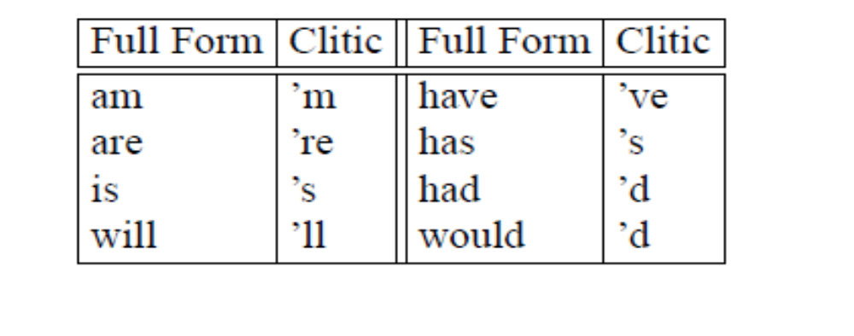
3.1.3 Cliticization
A clitic lies in between that of an affix and a word.
The phonological behavior of clitics is like affixes; they tend to be short and unaccented
Their syntactic behavior is more like words, often acting as pronouns, articles, conjunctions, or verbs.
Clitics preceding a word are proclitics, while those following are enclitics.

Slide 53
3.1.3 Cliticization
Ambiguity in clitics:
clitics in English are ambiguous;
Ex: she’s can mean she is or she has.
However, correctly segmenting off clitics in English is simplified by the presence of the apostrophe.
Morphology and FSTs

Slide 54
3.1.4 Non-concatenative Morphology
The kind of morphology in which a word is composed of a string of morphemes concatenated together is called concatenative morphology.
A number of languages have extensive non-concatenative morphology, in which morphemes are combined in more complex ways.
Morphology and FSTs

Slide 55
3.1.5 Agreement
There are agreement processes
1. The plural morpheme is marked on both nouns and verbs in English
We say that the subject noun and the main verb in English have to agree in number,
Ex: The two must either be both singular or both plural.
2. nouns, adjectives, and sometimes verbs in many languages are marked for gender
Ex: Many languages have 2 genders, which are referred to as masculine and feminine.
Bantu language of Africa, has as many as 20 genders.
When the number of classes is very large, we often refer to them as noun classes instead of genders.

Slide 56
3.2 FINITE-STATE MORPHOLOGICAL PARSING
Problem of parsing English morphology:
Input forms: to take input forms like those in the first column
Output forms: like those in the second column
The goal of morphological parsing is to list all possible parses
Input | Morphological parsed output
cats cat cities geese goose gooses merging caught | cat +N +PL cat +N +SG city +N +PL goose +N +PL (goose +N +SG) or (goose +V) goose +V +3P+SG merge +V +PRES-PART (catch +V +PAST-PART) or (catch +V +PAST)
Format for Morphological parsed output: stem form + POS category (N/V) + Afffix description (PL/SG/3P +SG/PRES-PART/PAST-PART/PAST)

Slide 57
3.2 Finite-State Morphological Parsing
Parsing English morphology
Input | Morphological parsed output
cats cat cities geese goose gooses merging caught | cat +N +PL cat +N +SG city +N +PL goose +N +PL (goose +N +SG) or (goose +V) goose +V +3P+SG merge +V +PRES-PART (catch +V +PAST-PART) or (catch +V +PAST)

Slide 58
3.2 Finite-State Morphological Parsing
Parsing English morphology – how to specify output?
The second column contains the stem of each word as well as assorted morphological features.
How to specify additional information about the stem?
  Ex: feature +N means that the word is a noun
  +SG means it is singular
  +PL that it is plural.
Note: input forms (like caught, goose) will be ambiguous between different morphological parses.
The goal of morphological parsing is to list all possible parses.
Task of disambiguating among morphological parses in Ch. 5 – POS tagging

Slide 59
3.2 Finite-State Morphological Parsing
We need at least the following to build a morphological parser:
  Lexicon: the list of stems and affixes, together with basic information (POS category) about them
      Ex: Noun stem or Verb stem, etc.
  Morphotactics: the model of morpheme ordering that explains which classes of morphemes can follow other classes of morphemes inside a word.
      Ex: the rule that English plural morpheme follows the noun rather than preceding it.
  Orthographic rules: these spelling rules are used to model the changes that occur in a word, usually when two morphemes combine
      Ex: the y→ie spelling rule changes city + -s to cities rather than citys

Slide 60
Background - Morphology and Finite State Automata
  Lexicon: list of stems and affixes (with corresponding part of speech (pos))
  Morphotactics of the language: model of how and which morphemes can be affixed to a stem
  Orthographic rules: spelling modifications that may occur when affixation occurs
Most morphological phenomena can be described with regular expressions
so finite state techniques are used to represent morphological processes
We can use the machinery provided by FSAs to capture facts about morphology
    Accept strings that are in the language
    Reject strings that are not
    to do it in a way that does not requires to list all the words in the language

Slide 61
Background
How to represent a simple version of the lexicon
  for the sub-problem of morphological recognition
  How to use FSAs to model morphotactic knowledge?
Finite-state transducer (FST)
  a way of modeling morphological features in the lexicon, and addressing morphological parsing.
How to use FSTs to model orthographic rules?
Morphology and FSTs

Slide 62
3.3 Construction of a Finite state Lexicon
Lexicon:
  A lexicon is a repository for words.
  The simplest possible lexicon would consist of an explicit list of every word of the language (including abbreviations (“AAA”) and proper names (“Jane” or “Beijing”))
    a, AAA, AA, Aachen, aardvark, aardwolf, aba, abaca, aback, . . .
  Inconvenient or impossible to list every word in the language
Computational lexicon:
  is structured with a list of each of the stems and affixes of the language
  together with a representation of the morphotactics that tells us how they can fit together.
  There are many ways to model morphotactics; one of the most common is the finite-state automaton.

Slide 63
3.3 Construction of a Finite state Lexicon
Construct a simple finite-state model for English nominal inflection
1. Identify stem classes
2. How many affix classes?
3. Examples in a table form listing all stem and affix classes
4. Construct FSA.

Slide 64
3.3 Construction of a Finite state Lexicon
Construct a simple finite-state model for English nominal inflection
1. Identify stem classes
2. How many affix classes?
3. Examples in a table form listing all stem and affix classes
4. Construct FSA.
Reg-noun | Irreg-pl-noun | Irreg-sg-noun | plural
fox cat aardvark | geese sheep mice | goose sheep mouse | -s

Slide 65
3.3 Construction of a Finite state Lexicon
Construct a simple finite-state model for English nominal inflection
1. Identify stem classes
This lexicon has three stem classes
  reg-noun
  irreg-sg-noun
  irreg-pl-noun
2. How many affix classes?
  -plural -s
3. Examples in a table form listing all stem and affix classes:
Reg-noun | Irreg-pl-noun | Irreg-sg-noun | plural
fox cat aardvark | geese sheep mice | goose sheep mouse | -s
Note: plural of sheep is sheep

Slide 66
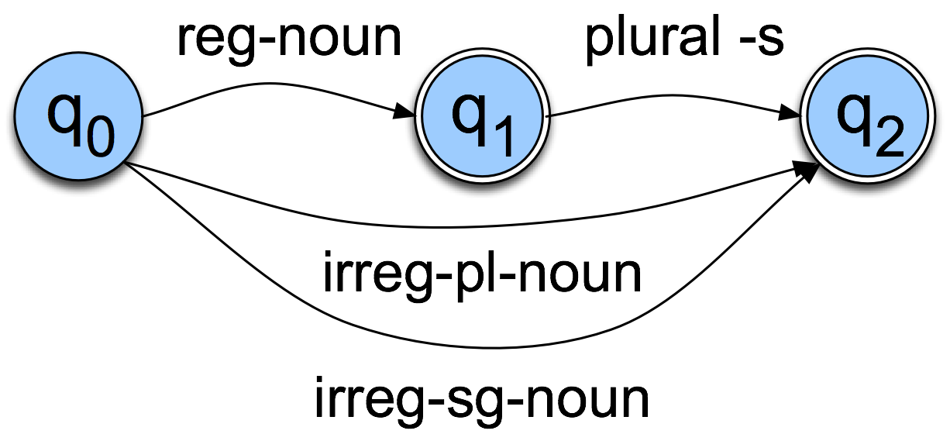
3.3 Construction of a Finite state Lexicon
Construct a simple finite-state model for English nominal inflection

Slide 67
3.3 Construction of a Finite state Lexicon
The FSA assumes that the lexicon includes regular nouns (reg-noun) that take the regular -s plural (e.g., cat, dog, fox, aardvark).
These are the vast majority of English nouns
We will ignore the fact that the plural of words like fox have an inserted e: foxes.
The lexicon also includes irregular noun forms that do not take -s, both singular irreg-sg-noun (goose, mouse) and plural irreg-pl-noun (geese, mice).
Summarizing Rules:
  Regular singular nouns stay as is
  Regular plural nouns have an -s on the end
  Irregulars stay as is

Slide 68
A finite-state automaton for English nominal inflection
Show that the above FSA recognizes the following words:
Reg-noun | Irreg-pl-noun | Irreg-sg-noun | plural
fox cat aardvark | geese sheep mice | goose sheep mouse | -s

Slide 69
Expand the Arcs with Stems and Affixes
dog
cat
geese
child
A finite-state automaton for English nominal inflection

Slide 70
3.3 Construction of a Finite state Lexicon
Construct FSA for English verbal inflection
1. Identify stem classes
2. How many affix classes?
3. Examples in a table form listing all stem and affix classes
4. Construct FSA for verbal inflection
Reg-verb-stem | Irreg-verb-stem | Irreg-past-verb | past | Past-part | Pres-part | 3sg
walk fry talk impeach | cut speak sing | caught ate eaten sang | -ed | -ed | -ing | -s

Slide 71
3.3 Construction of a Finite state Lexicon
Construct FSA for English verbal inflection
1. Identify stem classes
This lexicon has three stem classes
  reg-verb-stem,
  irreg-verb-stem,
  irreg-past-verb
2. How many affix classes? four affix classes
  -ed past
  -ed participle
  -ing participle
  - third singular -s
3. Examples in a table form listing all stem and affix classes:
Reg-verb-stem | Irreg-verb-stem | Irreg-past-verb | past | Past-part | Pres-part | 3sg
walk fry talk impeach | cut speak sing | caught ate eaten sang | -ed | -ed | -ing | -s

Slide 72
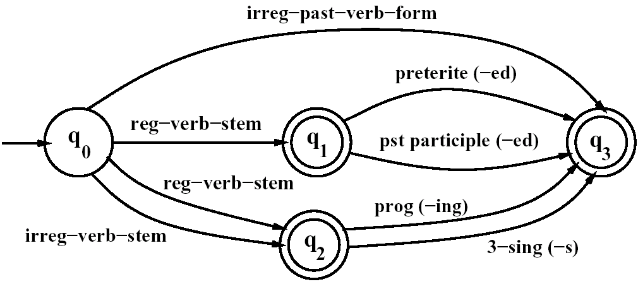
3.3 Construction of a Finite state Lexicon
An FSA for English verbal inflection
Reg-verb-stem | Irreg-verb-stem | Irreg-past-verb | past | Past-part | Pres-part | 3sg
walk fry talk impeach | cut speak sing | caught ate eaten sang | -ed | -ed | -ing | -s

Slide 73
Automata for modeling English derivation
Morphology and FSTs

Slide 74
Automata for modeling English derivation
English derivational morphology is more complex than English inflectional morphology
Automata of modeling English derivation tends to be quite complex.
  Some even based on CFG
1. Construct FSA for modeling English adjectives:
Examples of English adjectives:
big, bigger, biggest, cool, cooler, coolest, coolly
happy, happier, happiest, happily red, redder, reddest
unhappy, unhappier, unhappiest, unhappily real, unreal, really
clear, clearer, clearest, clearly, unclear, unclearly

Slide 75
Automata for modeling English derivation
Consider a simpler case of derivation: the morphotactics of English adjectives.
Construct FSA for modeling English adjectives:
Considering following adjectives, identify stem and affix classes
Data we want to model – Adjectives becoming
  Opposites(-un), comparatives (-er, est), adverbs (-ly)
Examples:
big, bigger, biggest
cool, cooler, coolest, coolly
red, redder, reddest
clear, clearer, clearest, clearly, unclear, unclearly
happy, happier, happiest, happily
unhappy, unhappier, unhappiest, unhappily
real, unreal, really

Slide 76
Automata for modeling English derivation
Stem class: adj-stem
Affix classes: -er, -est, -ly, -un
adjectives can have an optional prefix ( un-), an obligatory root (big, cool, etc.) and an optional suffix ( -er, -est, or -ly).
Draw FSA
Examples:
big, bigger, biggest
cool, cooler, coolest, coolly
red, redder, reddest
clear, clearer, clearest, clearly, unclear, unclearly
happy, happier, happiest, happily
unhappy, unhappier, unhappiest, unhappily
real, unreal, really

Slide 77
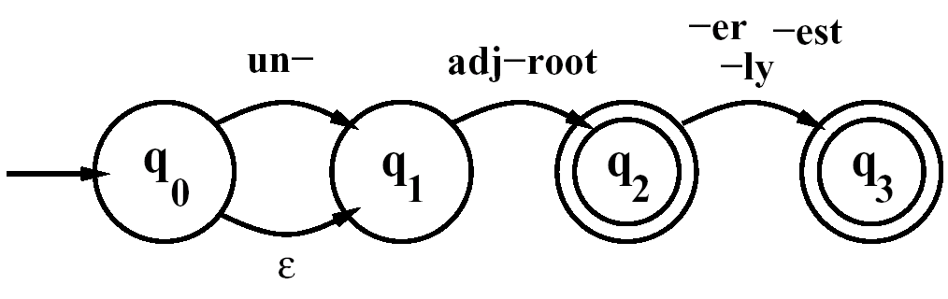
Automata for modeling English derivation
Stem class: adj-root
Affix classes: -er, -est, -ly, -un
adjectives can have an optional prefix ( un-), an obligatory root (big, cool, etc.) and an optional suffix ( -er, -est, or -ly).
Examples:
big, bigger, biggest
cool, cooler, coolest, coolly
red, redder, reddest
clear, clearer, clearest, clearly, unclear, unclearly
happy, happier, happiest, happily
unhappy, unhappier, unhappiest, unhappily
real, unreal, really
An FSA for a fragment of English adjective
Morphology #1
Any errors in FSA ? It also recognises unbig, redly, and realest? How to correct?

Slide 78
Automata for modeling English derivation
The FSA#1 recognizes all the listed adjectives, and ungrammatical forms like unbig, redly, and realest.
Set up separate classes of roots and specify their possible suffixes.
adj-root₁ to include adjectives that can occur with un- and -ly (clear, happy, and real)
adj-root₂ to include adjectives that cannot (big, small) which cannot occur with un- and -ly
This gives an idea of the complexity to be expected from English derivation
Revise version 1 by considering 2 stem classes

Slide 79
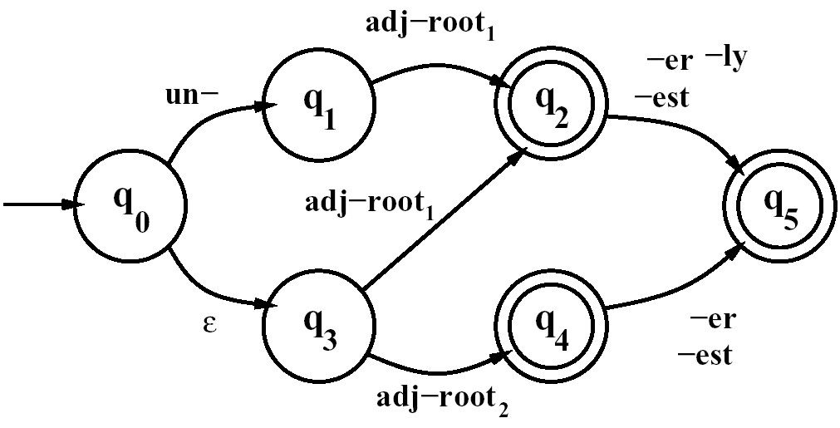
Automata for modeling English derivation
#1 is revised to become #2.
An FSA for a fragment of English adjective Morphology #2
Adj-root₁: clear, real
Adj-root₂: big, red

Slide 80
FSAs can also represent the Lexicon
Expand each non-terminal arc in the previous FSA into a sub-lexicon FSA (ex. adj_root₂ = {big, red}) and then expand each of these stems into its letters (e.g. red → r e d) to get a recognizer for adjectives
r
e
ε
q1
q2
q3
q0
b
d
q4
q5
i
g
q6

Slide 81
Automata for modeling English derivation
FSA as morphological recognizers
We can now use these FSAs to solve the problem of morphological recognition;
  determining whether an input string of letters makes up a legitimate English word or not.
  do this by taking the morphotactic FSAs, and plug in each ‘sub-lexicon’ into the FSA.
  That is, expand each arc (e.g. the reg-noun-stem arc) with all the morphemes that make up the set of reg-noun-stem.
The resulting FSA can then be defined at the level of the individual letter.

Slide 82
Automata for modeling English derivation
Construct Expanded FSA at the level of the individual letter for following English nouns with their inflection
Exs: fox, cat, goose, geese
Morphology and FSTs

Slide 83
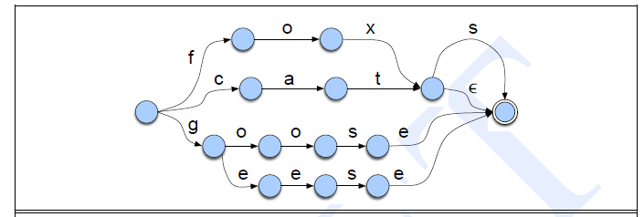

Automata for modeling English derivation
Expanded FSA for a few English nouns with their inflection.
What about –es?

Slide 84
Automata for modeling English derivation
Expanded FSA for a few English nouns with their inflection.
Note that this automaton will incorrectly accept the input foxs.
We will deal with the inserted e in foxes using FSTs.

Slide 85
Automata for modeling English derivation
Construct Expanded FSA at the level of the individual letter for following English nouns with their inflection
Exs: fox, cat, dog, donkey, goose, geese, aardvark, sheep, mouse, mice
We will deal with the inserted e in foxes using FSTs.

Slide 86
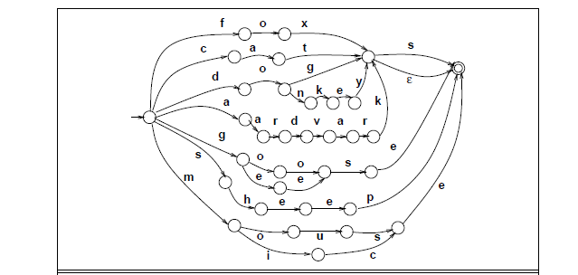
Automata for modeling English derivation
Expanded FSA for a few English nouns with their inflection.
Note that this automaton will incorrectly accept the input foxs.
We will deal with the inserted e in foxes using FSTs.

Slide 87
Automata for modeling English derivation
The Nominal Inflection FSA of is expanded with sample regular and irregular nouns for each class.
We can recognize strings like aardvarks by starting at the initial state, and comparing the input letter by letter with each word on each outgoing arc.

Slide 88
Automata for modeling English derivation
Construct FSA for English nominal, verbal and adjective derivational morphology to produce nouns adverbs
Input – noun, verb, adjective
Output – noun, adverb
Morphology and FSTs

Slide 89
Background - Derivational Morphology
Nominalization in English: The formation of new nouns, often from verbs or adjectives
Suffix | Base Verb/Adjective | Derived Noun
-ation | computerize (V) | computerization
-ee | appoint (V) | appointee
-er | kill (V) | killer
-ness | fuzzy (A) | fuzziness
  Adjectives derived from nouns or verbs
Suffix | Base Noun/Verb | Derived Adjective
-al | computation (N) | computational
-able | embrace (V) | embraceable
-less | clue (A) | clueless
Note: computation – noun
computational and computative - adjective
computatively - adverb

Slide 90
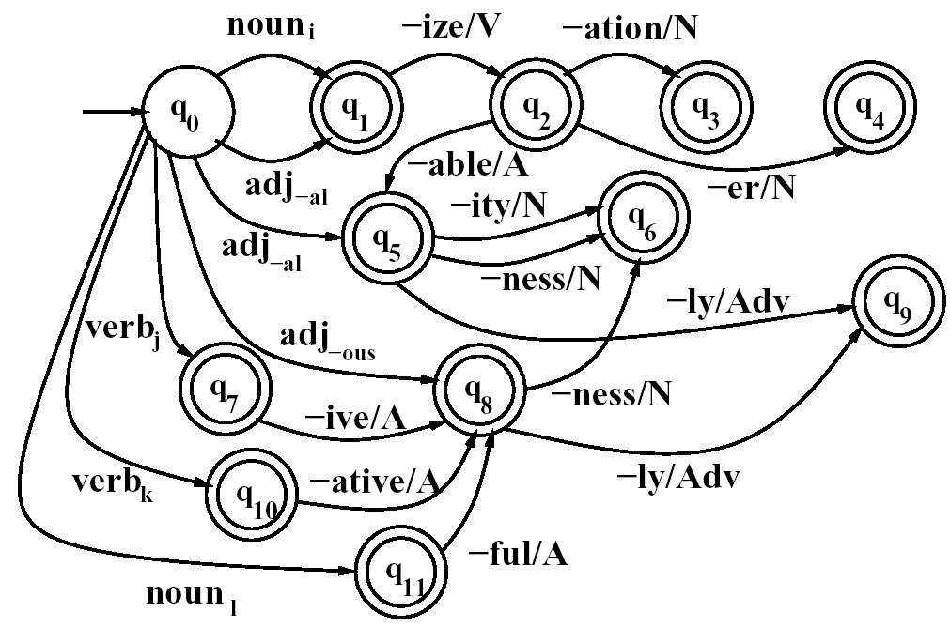
Automata for modeling English derivation
An FSA for another fragment of English derivational morphology
Input – noun, verb, adjective
Output – noun, adverb

Slide 91
Automata for modeling English derivation
2. Construct FSA for English nominal and verbal derivational morphology
FSA to model a number of derivational facts such as
  the well known generalization that any verb ending in -ize can be followed by the nominalizing suffix -ation
  Ex1: The verb fossilize we can predict the word fossilization by following states q₀, q₁, and q₂.
  Ex2: Adjectives ending in -al or -able at q₅ (equal, formal, realizable) can take the suffix -ity, or sometimes the suffix -ness to state q₆ (naturalness, casualness).
Exceptions and examples: Work out individual exceptions to many of the constraints, and give examples of some of the various noun and verb classes.
Morphology and FSTs

Slide 92
FSAs can also represent the Lexicon
Expand each non-terminal arc in the previous FSA into a sub-lexicon FSA (ex. adj_root₂ = {big, red}) and then expand each of these stems into its letters (e.g. red → r e d) to get a recognizer for adjectives
r
e
ε
q1
q2
q3
q0
b
d
q4
q5
i
g
q6

Slide 93
But…..
Covering the whole lexicon this way will require very large FSAs with consequent search and maintenance problems
  Adding new items to the lexicon means recomputing the whole FSA
  Non-determinism
  Some stems require modification when they acquire affixes
FSAs tell us whether a word is in the language or not – but usually we want to know more:
  What is the stem?
  What are the affixes and what sort are they?
  We used this information to recognize the word: why can’t we store it?

Slide 94
Background - 3.2 FINITE-STATE MORPHOLOGICAL PARSING
Problem of parsing English morphology:
Input forms: to take input forms like those in the first column
Output forms: like those in the second column
The goal of morphological parsing is to list all possible parses
Input | Morphological parsed output
cats cat cities geese goose gooses merging caught | cat +N +PL cat +N +SG city +N +PL goose +N +PL (goose +N +SG) or (goose +V) goose +V +3P+SG merge +V +PRES-PART (catch +V +PAST-PART) or (catch +V +PAST)

Slide 95
Parsing with Finite State Transducers
Given the input, (Ex:) cats, we would like to produce cat +N +PL.
cats →cat +N +PL
Kimmo Koskenniemi’s two-level morphology
  Idea: word is a relationship between lexical level (its morphemes) and surface level (its orthography)
  lexical level : Representing a simple concatenation of morphemes making up a word
  surface level : Representing the actual spelling of the final word.
  Morphological parsing : find the mapping (transduction) between lexical and surface levels
Morphological parsing is implemented by building mapping rules that maps letter sequences like cats on the surface level into morpheme and features sequence like cat +N +PL on the lexical level. The lexical level contains stem for a word, followed by the morphological information +N +PL which tells us that cats is a plural noun
Lexical (morpheme)
 | c | a | t | +N | +PL
 | c | a | t | s
Surface (word)

Slide 96
FST
The automaton we use for performing the mapping between these two levels is the finite-state transducer or FST.
A transducer maps between one set of symbols and another;
Thus an FST can be seen as a two-tape automaton which recognizes or generates pairs of strings.
The FST has a more general function than an FSA:
  An FSA defines a formal language
  An FST defines a relation between sets of strings.
Another view of an FST:
– A machine reads one string and generates another

Slide 97
3.2 Finite-State Morphological Parsing
Morphological Parsing with FST
A formal definition of FST (based on the Mealy machine extension to a simple FSA):
  Q: a finite set of N states q₀, q₁,…, q_{N}
  Σ: a finite alphabet of complex symbols. Each complex symbol is composed of an input-output pair i : o; one symbol I from an input alphabet I, and one symbol o from an output alphabet O, thus Σ ⊆ I×O. I and O may each also include the epsilon symbol ε.
  q₀: the start state
  F: the set of final states, F ⊆ Q
  δ(q, i:o): the transition function or transition matrix between states. Given a state q ∈ Q and complex symbol i:o ∈ Σ, δ(q, i:o) returns a new state q’ ∈ Q. δ is thus a relation from Q × Σ to Q.

Slide 98
Difference between Mealy machine and Moore machine
Mealy Machine : defined as a machine in theory of computation whose output values are determined by both its current state and current inputs.
Mealy Machine –Output depends on current state as well as current input.
If input changes, output also changes.
It is difficult to design.
Moore machine : defined as a machine in theory of computation whose output values are determined only by its current state.
Moore Machine –Output depends only upon current state.
If input changes, output does not change.
Easy to design.
Morphology and FSTs

Slide 99
FST for a 2-level Lexicon
c:c
a:a
t:t
Ex:
q0
q1
q2
q3
g
q4
q5
q6
q7
e
o:e
o:e
s
Reg-n | Irreg-pl-n | Irreg-sg-n
c a t | g o:e o:e s e | g o o s e
Notes:
NB: by convention, a:a is written just a

Slide 100
Ex: FST is a 5-tuple consisting of
  Q: set of states {q0,q1,q2,q3,q4}
  Σ: an alphabet of complex symbols, each an i/o pair s.t. i ∈ I (an input alphabet) and o ∈ O (an output alphabet) and Σ is in I x O
  q0: a start state
  F: a set of final states in Q {q4}
  δ(q,i:o): a transition function mapping Q x Σ to Q
o:a
m:b
o:a
o:a
?:!
q0
q1
q2
q3
q4
Notes:
Input is rhs; output is lhs

Slide 101
3.2 Finite-State Morphological Parsing
Morphological Parsing with FST
FST as recognizer:
  a transducer that takes a pair of strings as input and output accept if the string-pair is in the string-pair language, and a reject if it is not.
FST as generator:
  a machine that outputs pairs of strings of the language. Thus the output is a yes or no, and a pair of output strings.
FST as transducer:
  A machine that reads a string and outputs another string.
FST as set relater:
  A machine that computes relation between sets.

Slide 102
3.2 FSA vs.FST
FSA
  An FSA represents a set of strings {walk, walks, walked, . . .}
  Regular language.
  A recognizer function.
  recognize(str) -> yes or no
FST
  An FST represents a set of pairs of strings (input,output pairs)
  { (walk, walk+V), (walked, walk+V+PAST), (walked, walk+V+PASTPART) ...}
  Regular relation.
  A transducer function: maps input to zero or more outputs.
  transduce(walked) --> {walk+V+PAST, walk+V+PASTPART}
  Can return multiple answers if ambiguity:
  Ex: if we do not have POS-tagged input, “walk” could be
  the verb “They walk to the store” versus the noun “I took a walk”.

Slide 103
3.2 Finite-State Morphological Parsing
Morphological Parsing with FST
FSAs are isomorphic to regular languages, FSTs are isomorphic to regular relations.
Regular relations are sets of pairs of strings, a natural extension of the regular language, which are sets of strings.
FSTs are closed under union, but generally they are not closed under difference, complementation, and intersection.
Two useful closure properties of FSTs:
  Inversion: If T maps from I to O, then the inverse of T, T⁻¹ maps from O to I.
  Composition: If T₁ is a transducer from I₁ to O₁ and T₂ a transducer from I₂ to O₂, then T₁ 。 T₂ maps from I₁ to O₂
Note on Closure Properties and Regular Languages:
A set is closed with respect to that process if the process can always be completed with elements in the set.
Ex: the set of even natural numbers, 2, 4, 6, 8,….., is closed by the addition because the sum of any two of them is another even number.
A language accepted by a DFA is called a regular language.

Slide 104
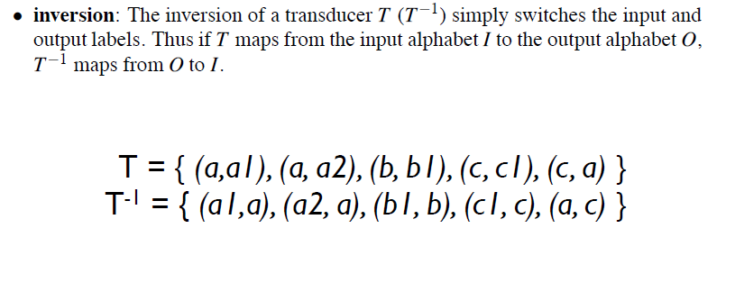
Inversion
Inversion is useful because it makes it easy to convert a FST-as-parser into an FST-as-generator.
Composition is useful because it allows to take two transducers that run in series and replace them with one more complex transducer.

Slide 105
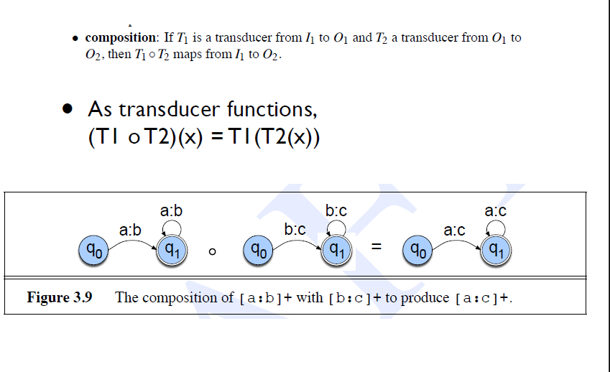
Composition
Note: x is a input sequence.

Slide 106
3.2 Finite-State Morphological Parsing
Morphological Parsing with FST
For two-level morphology it is convenient to view an FST as having two tapes.
The upper or lexical tape, is composed from characters from the left side of the a : b pairs;
the lower or surface tape, is composed of characters from the right side of the a : b pairs.
Thus each symbol a : b in the transducer alphabet expresses how the symbol a from one tape is mapped to the symbol b on the another tape.
For example a : ε means that an a on the upper tape will correspond to nothing on the lower tape.
Just as for an FSA, we can write regular expressions in the complex alphabet .
Since it’s most common for symbols to map to themselves, in two-level morphology we call pairs like a : a default pairs, and refer to them by the single letter a

Slide 107

3.2 Finite-State Morphological Parsing
Morphological Parsing with FST
Build an FST morphological parser from earlier morphotactic FSAs and lexica by adding an extra “lexical” tape and the appropriate morphological features.
Augment the following Figure with the nominal morphological features (+SG and +PL) that correspond to each morpheme.
Note that these features map to the empty string ε or the word/morpheme boundary symbol # since there is no segment corresponding to them on the output tape.

Slide 108
Background - A finite-state automaton for English nominal inflection
Show that the above FSA recognizes the following words:
Reg-noun | Irreg-pl-noun | Irreg-sg-noun | plural
fox cat aardvark | geese sheep mice | goose sheep mouse | -s

Slide 109

FST for English Nominal Inflection Tnum.
+N:ε
reg-n
+PL:^s#
q1
q4
+SG:#
irreg-n-sg
+N:ε
q0
q2
q5
q7
+SG:#
irreg-n-pl
q3
q6
+PL:#
+N:ε
c
a
t
+N
+PL
c
a
t
s
Transducer between Lexical to Intermediate level
Notes:
^ morpheme boundary
# word boundary

Slide 110
FST for English Nominal Inflection
A transducer for English nominal number(singular-plural) inflection Tnum.
Since both q1 and q2 are accepting states, regular nouns can have the plural suffix or not.
The morpheme-boundary symbol ˆ and word-boundary marker #
reg-n
+N:ε
q1
q4
+PL:^s#
+SG:#
q0
q2
+N:ε
q5
q7
irreg-n-sg
+SG:#
irreg-n-pl
q3
q6
+N:ε
+PL:#
c
a
t
+N
+PL
c
a
t
s

Slide 111
FST for a 2-level Lexicon
c:c
a:a
t:t
Ex:
q0
q1
q2
q3
g
q4
q5
q6
q7
e
o:e
o:e
s
Reg-n | Irreg-pl-n | Irreg-sg-n
c a t | g o:e o:e s e | g o o s e
Notes:
NB: by convention, a:a is written just a

Slide 112
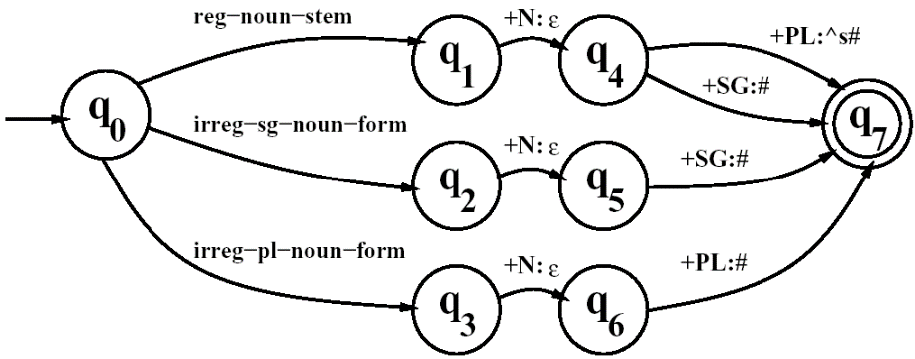
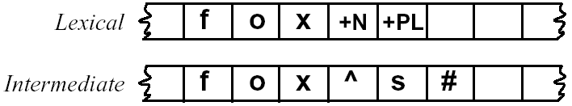
3.2 Finite-State Morphological Parsing
Morphological Parsing with FST
Inversion is useful because it makes it easy to convert a FST-as-parser into an FST-as-generator.
Composition is useful because it allows us to take two transducers than run in series and replace them with one complex transducer.
  T₁。T₂(S) = T₂(T₁(S) ) where S is an input sequence.
Reg-noun | Irreg-pl-noun | Irreg-sg-noun
fox fat fog aardvark | g o:e o:e s e sheep m o:i u:εs:c e | goose sheep mouse
A transducer for English nominal
number inflection T_{num}
Transducer between Lexical to Intermediate level

Slide 113
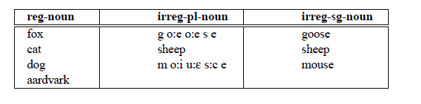
3.2 Morphological Parsing with FST
How to use Tnum as a morphological noun parser?
  augment with all the individual regular and irregular noun stems, replacing the labels such as regular-noun-stem
  update the lexicon for this transducer
  irregular plurals like geese will parse into the correct stem goose +N +PL.
  allow the lexicon to also have two levels.
  Since surface geese maps to underlying goose, the new lexical entry will be ‘g:g o:e o:e s:s e:e’.
  the two-level entry for fox will now be ‘f:f o:o x:x’,
  relying on the orthographic convention that f stands for f:f and so on, we can simply refer to it as fox and the form for geese as ‘g o:e o:e s e’.
Thus the lexicon will be as below:

Slide 114
3.2 Morphological Parsing with FST
Our proposed morphological parser needs to map surface forms like geese to lexical forms like goose +N +SG.
We could do this by cascading the lexicon below with the singular/plural automaton shown
Cascading two automata means running them in series with the output of the first feeding the input to the second.
reg-n
+N:ε
q1
q4
+PL:^s#
+SG:#
q0
q2
+N:ε
q5
q7
irreg-n-sg
+SG:#
irreg-n-pl
q3
q6
+N:ε
+PL:#

Slide 115
3.2 Morphological Parsing with FST
Conventions:
We would first represent the lexicon of stems in the above table as the FST Tstems shown next
This FST maps e.g. dog to reg-noun-stem.
In order to allow possible suffixes, Tstems allows the forms to be followed by @ SYMBOL the wildcard @ symbol;
@:@ stands for ‘any feasible pair’.
A pair of the form @:x, for example will mean ‘any feasible pair which has x on the surface level’,
The output of this FST would then feed the number automaton Tnum.

Slide 116
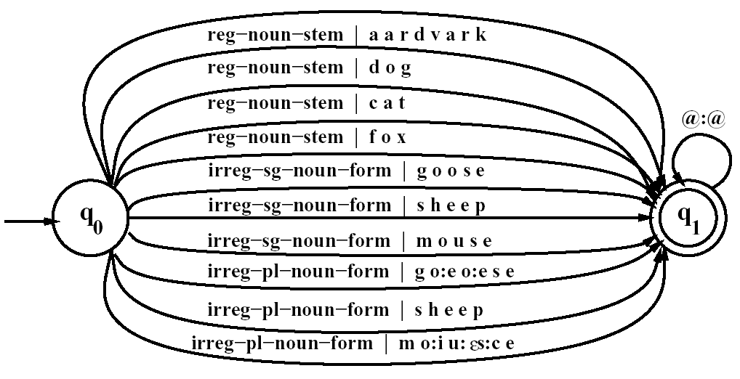
3.2 Morphological Parsing with FST
The transducer T_{stems}, which maps roots to their root-class

Slide 117
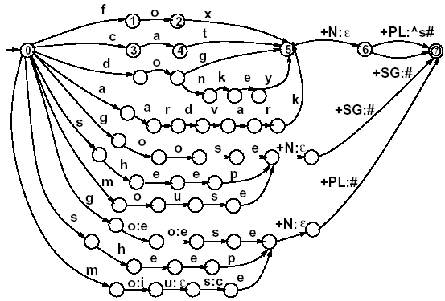
3.2 Finite-State Morphological Parsing
Morphological Parsing with FST
^: morpheme boundary
#: word boundary
A fleshed-out English nominal inflection FST
T_{lex} = T_{num}。T_{stems}
Transducer between Lexical to Intermediate level

Slide 118
3.6 Transducers and Orthographic rules
Morphology and FSTs

Slide 119
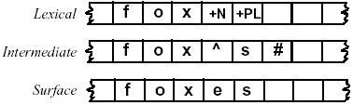
Parsing vs. Generation
We have run strings through these machines
  to recognize strings in the language
But recognition is usually not quite what we need
  • if we find some string in the language we might like to assign a structure to it (parsing)
  Or we might have some structure and we want to produce a surface form for it (production/generation)
Parsing the lexical tape from the surface tape
Generating the surface tape from the lexical tape.

Slide 120
Orthographic rules
The method described in the previous section will successfully recognize words like aardvarks and mice.
But just concatenating the morphemes does not work for cases where there is a spelling change;
it would incorrectly reject an input like foxes and accept an input like foxs.
We need to deal with the fact that English often requires spelling changes at morpheme boundaries by introducing spelling rules (or ortho-graphic rules)
We need a notation for writing such rules and FST to implement the rules as transducers.
In general, the ability to implement rules as a transducer is useful throughout speech and language processing.
Morphology and FSTs

Slide 121
Orthographic Rules
Define additional FSTs to implement spelling rules
Multiple spelling rules might apply for a given word.
All spelling rules execute in parallel.
Rewrite rules can be compiled into FSTs.

Slide 122
3.2 Finite-State Morphological Parsing
Orthographic Rules and FSTs
Spelling rules (or orthographic rules)
Name | Description of Rule | Example
Consonant doubling E deletion E insertion Y replacement K insertion | 1-letter consonant doubled before -ing/-ed Silent e dropped before -ing and -ed e added after -s, -z, -x, -ch, -sh, before -s -y changes to -ie before -s, -i before -ed Verb ending with vowel + -c add -k | beg/begging make/making watch/watches try/tries panic/panicked
  These spelling changes can be thought as taking as input a simple concatenation of morphemes and producing as output a slightly-modified concatenation of morphemes.
Note: The word “sync” ends in c but does not precede with vowel but with consonant ‘n’

Slide 123
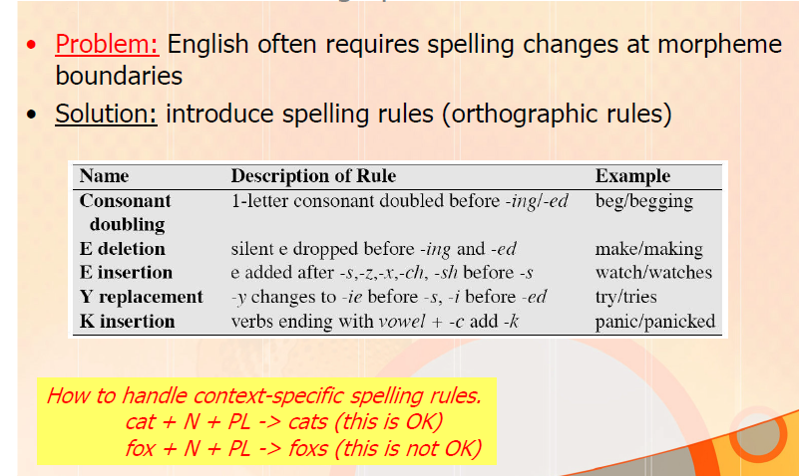
Orthographic Rules

Slide 124
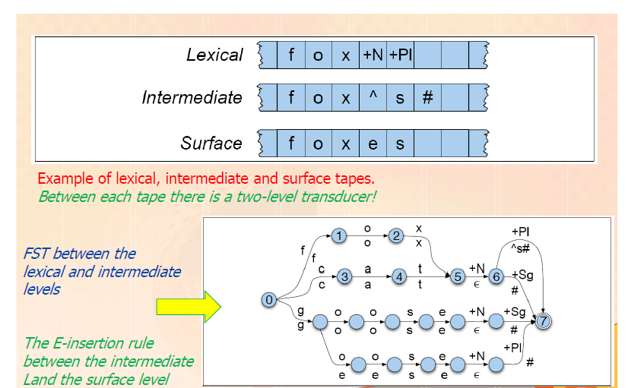
Orthographic Rules

Slide 125
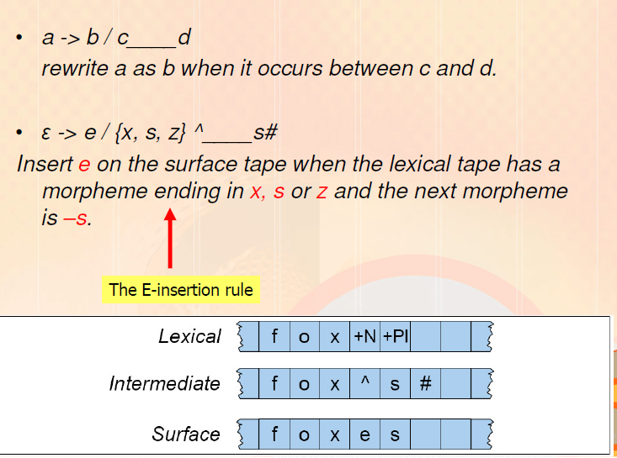
Rule Notation & E-insertion rule notation of Chomsky and Halle
Morphology and FSTs
Transducer between Intermediate to surface level

Slide 126
Rule Notation & E-insertion rule
Insertion rule from the rewrite rule:
Since the symbol epsilon means an empty transition, replacing it means inserting something.
Deleting boundary markers on the Intermediate to surface level:
The boundary markers are deleted by including the symbol
ˆ: ∈ in the default pairs for the transducer;
thus morpheme boundary markers are deleted on the surface level by default.
Note: symbol ˆ indicates a morpheme boundary.
The # symbol indicates a word boundary.
Morphology and FSTs

Slide 127
Transducer for E-insertion Rule
The idea in building a transducer for a particular rule is to express only the constraints necessary for that rule
  allowing any other string of symbols to pass through unchanged.
This rule is used to ensure that we can only see the ∈ :e pair if we are in the proper context.
So state q₀, to model only default pairs unrelated to the rule, is an accepting state
q₁, which models having seen a z, s, or x is an accepting state.
q₂ models having seen the morpheme boundary after the z, s, or x, and again is an accepting state.
State q₃ models having just seen the E-insertion; it is not an accepting state, since the insertion is only allowed if it is followed by the s morpheme and then the end-of-word symbol #.

Slide 128
Transducer for E-insertion Rule
The other symbol is used to safely pass through any parts of words that do not play a role in the E-insertion rule.
other means “any feasible pair that is not in this transducer”.
So for example when leaving state q₀, we go to q₁ on the z, s, or x symbols, rather than following the other arc and staying in q₀.
The semantics of other depends on what symbols are on other arcs;
since # is mentioned on some arcs, it is (by definition) not included in other, and thus, for example, is explicitly mentioned on the arc from q₂ to q₀.

Slide 129
Transducer for E-insertion Rule
Bad string:
A transducer needs to correctly reject a string that applies the rule when it should not.
One possible bad string would have the correct environment for the E-insertion, but have no insertion.
State q₅ is used to ensure that the e is always inserted whenever the environment is appropriate;
the transducer reaches q₅ only when it has seen an s after an appropriate morpheme boundary.
If the machine is in state q₅ and the next symbol is #, the machine rejects the string (because there is no legal transition on # from q₅).
the transition table for the rule makes the illegal transitions explicit with the “–” symbol.

Slide 130
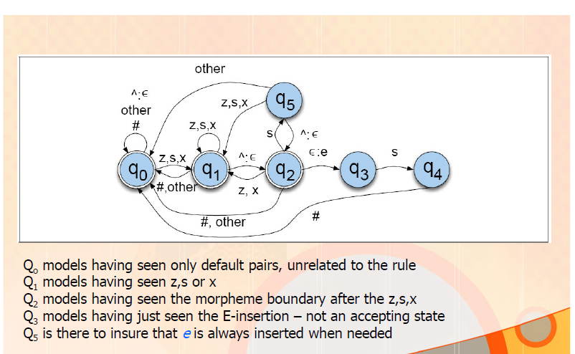
Transducer for E-insertion Rule
Q3 - the insertion is only allowed if it is followed by the s morpheme and then the end-of-word symbol # (at the intermediate tape)

Slide 131
State Transition table
Show the trace of E-insertion transducer on a sample input string
Ex: fox, class
Morphology and FSTs

Slide 132
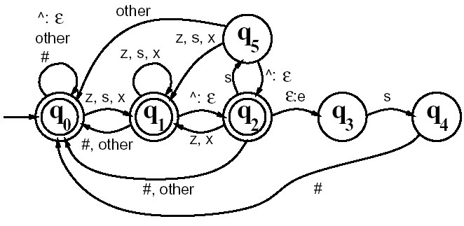
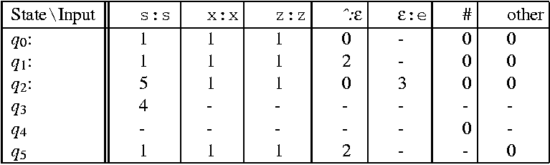
3.2 Finite-State Morphological Parsing
Orthographic Rules and FSTs
The transducer for the E-insertion rule

Slide 133
Orthographic Rules
Define additional FSTs to implement spelling rules
Multiple spelling rules might apply for a given word.
All spelling rules execute in parallel.
Rewrite rules can be compiled into FSTs.

Slide 134
3.7 Combining FST Lexicon and Rules
Generating or parsing with FST Lexicon and Rules:
How to combine lexicon and rule transducers for parsing and generating?
  The architecture of a two-level morphology system, used for parsing or generating.
  The lexicon transducer maps between
  the lexical level, with its stems and morphological features, and
  an intermediate level that represents a simple concatenation of morphemes.
  Then a host of transducers, each representing a single spelling rule constraint, all run in parallel so as to map between this intermediate level and the surface level.
  Note: we could have chosen to run all the spelling rules in series (as a long cascade), if we slightly changed each rule

Slide 135
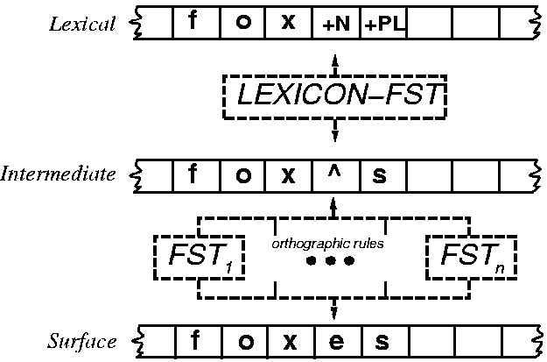
3.7 Combining FST Lexicon and Rules
Generating or parsing with FST lexicon and rules
Top-down: Generation of a string given its structure Ex: from fox+N+PL to foxes
Bottom-up: parsing (analysis) to produce its structure from a given string Ex: from foxes to fox+N+PL

Slide 136
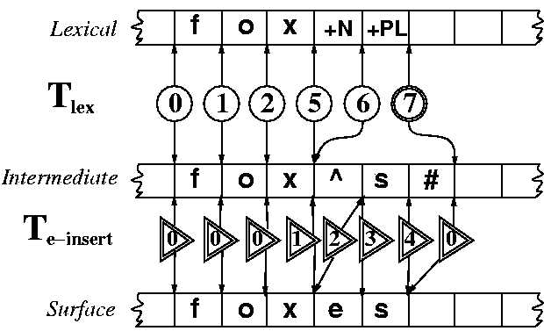
3.7 Combining FST Lexicon and Rules
Accepting foxes: The lexicon transducer Tlex cascaded with the E-insertion transducer
Note: Two Generating FSTs
Trace of the system accepting the mapping from fox +N +PL to foxes
T lex: Lexical to Intermediate
T e-insert: Intermediate to Surface
Initially assume both Intermediate and Surface tapes as blank for generation

Slide 137
3.7 Combining FST Lexicon and Rules
The power of FSTs is that the exact same cascade with the same state sequences is used
  when machine is generating the surface form from the lexical tape, or
  When it is parsing the lexical tape from the surface tape.
Ex: For generation, assume the Intermediate and Surface tapes blank.
  if we run the lexicon transducer, given fox +N +PL, it will produce foxˆs# on the Intermediate tape via the same states that it accepted the Lexical and Intermediate tapes in our earlier example.
  If we then allow all possible orthographic transducers to run in parallel, we will produce the same surface tape

Slide 138
3.7 Combining FST Lexicon and Rules
Parsing vs. Generation: which is more complex?
Parsing can be slightly more complicated than generation, because of the problem of ambiguity.
  For example, foxes could be fox +V +3SG as well as fox +N +PL
  Ex: foxes can also be a verb (meaning “to baffle or confuse”)
Hence the lexical parse for foxes could be fox +V +3Sg as well as fox +N +PL.
How to know which one is the proper parse?
for ambiguous cases, the transducer is not capable of deciding
Disambiguating requires external evidence such as the surrounding words.
  foxes is a noun in the sequence I saw two foxes yesterday
  but a verb in the sequence That trickster foxes me every time!.
  disambiguation algorithms in Ch. 5
In the absence of such external evidence, the transducer can
  enumerate the possible choices;
  so we can transduce foxˆs# into both fox +V +3SG and fox +N +PL.

Slide 139
Useful Operations on Transducers
Cascade: running 2+ FSTs in sequence
Composition: apply FST2 transition function to result of FST1 transition function
Inversion: exchanging the input and output alphabets (recognize and generate with same FST)

Slide 140
Useful Operations on Transducers
The architecture of a two-level cascade of transducers
Cascading two automata means running them in series with the output of the first feeding the input to the second
Cascades can be of arbitrary depth, and each level might be built out of many individual transducers.
The cascade has two transducers in series:
  the transducer mapping from the lexical to the intermediate levels
  and the collection of parallel transducers mapping from the intermediate to the surface level
The cascade can be run top-down to generate a string, or bottom-up to parse it;
Problem: show a trace of the system accepting the mapping from class +N +PL to classes.

Slide 141
Porter Stemmer (1980)
Building a transducer from a lexicon plus rules is the standard algorithm for morphological parsing
There are simpler algorithms that do not require the large on-line lexicon demanded by this algorithm.
These are used in Information Retrieval (IR) tasks like web search (Ch. 23)
  in which a query such as a Boolean combination of relevant keywords or phrases, e.g., (apple OR orange OR mango) returns documents that have these words in them.
  Since a document with the word apples might not match the keyword apple, IR systems first run a stemmer on the query and document words.
  Morphological information in IR is thus only used to determine that two words have the same stem; the suffixes are thrown away.

Slide 142
3.4 Lexicon-Free FSTs: the Porter Stemmer
One of the mostly widely used stemmming algorithms is the simple and efficient Porter (1980) algorithm
  which is based on a series of simple cascaded rewrite rules.
Since cascaded rewrite rules could be easily implemented as an FST, we can think of the Porter algorithm as a lexicon-free FST stemmer
Cascades rewrite rules (e.g. misunderstanding --> misunderstand --> understand --> …)
The algorithm contains rules like these:
  ATIONAL → ATE (e.g., relational → relate)
  ING → ε if stem contains vowel (e.g., motoring → motor)
Problem?

Slide 143
3.4 Lexicon-Free FSTs: the Porter Stemmer
Problem:
  Not perfect: error of commission, omission
Errors of Commission |  | Errors of Omission
organization | organ | European | Europe
doing | doe | analysis | analyzes
generalization | generic | matrices | matrix
numerical | numerous | noise | noisy
policy | police | sparse | sparsity
Doe is a deer

Slide 144
Summary: FSA and FST
Morphology and FSTs

Slide 145
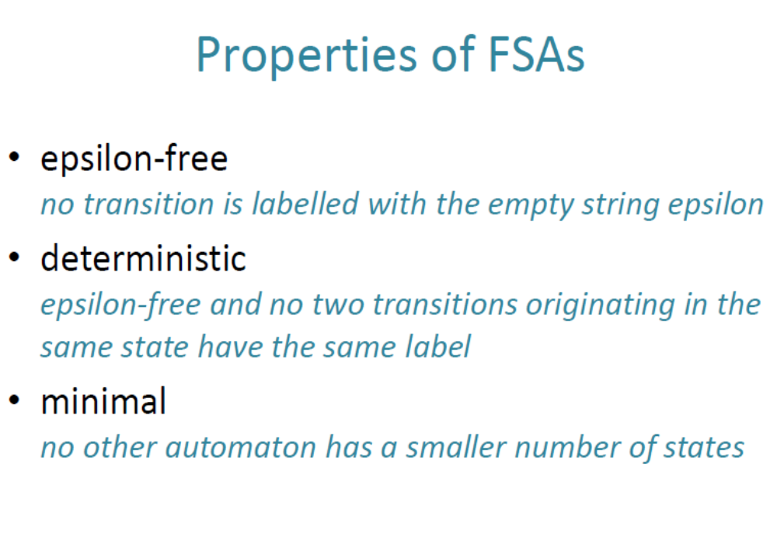
Morphology and FSTs

Slide 146
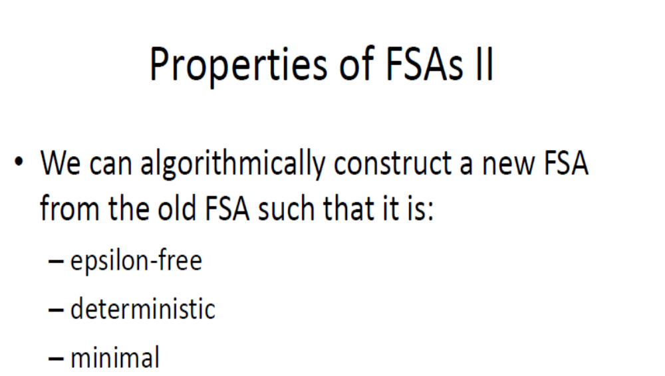
Morphology and FSTs

Slide 147
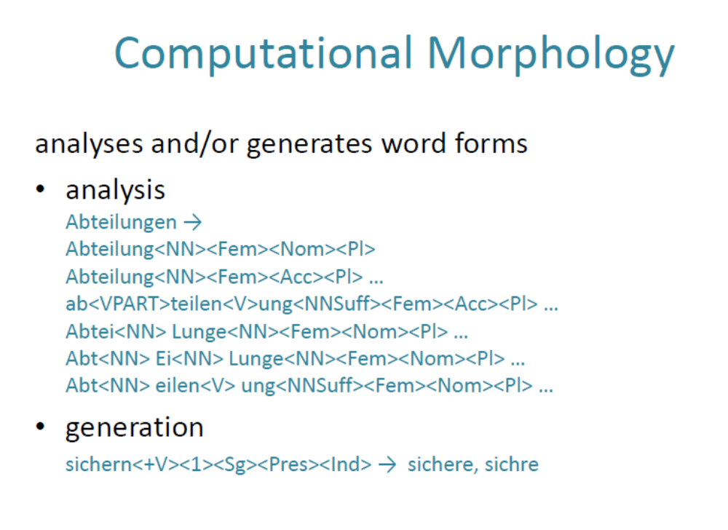
Morphology and FSTs

Slide 148
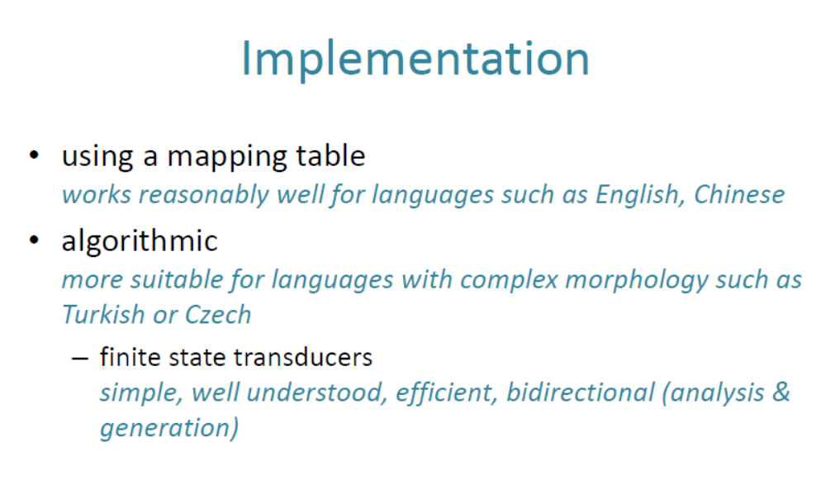
Morphology and FSTs

Slide 149
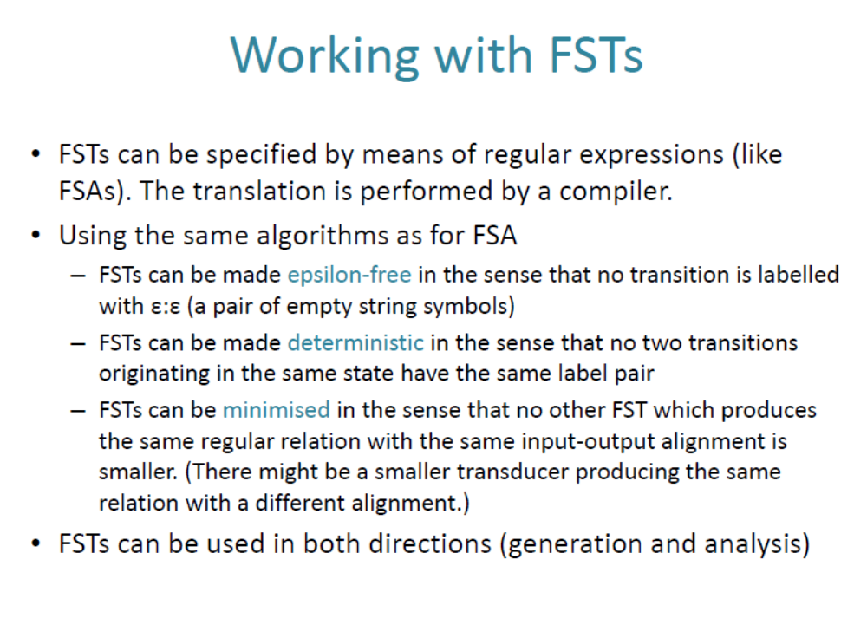
Morphology and FSTs

Slide 150
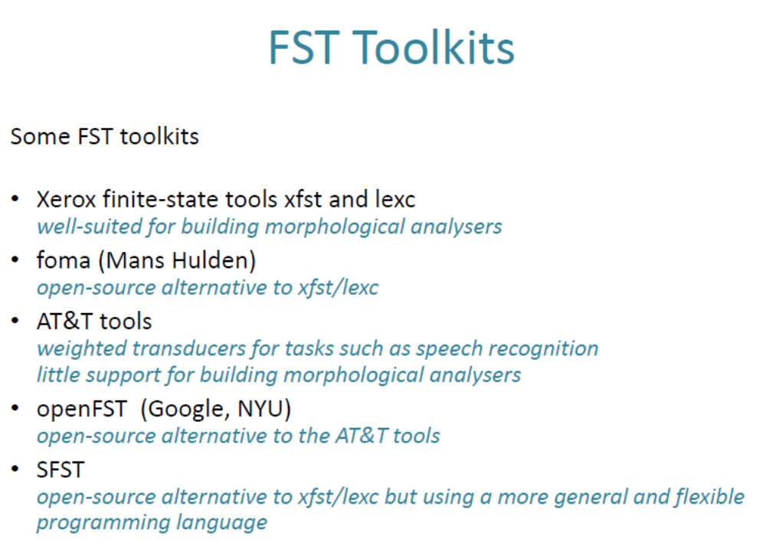
Morphology and FSTs

Slide 151
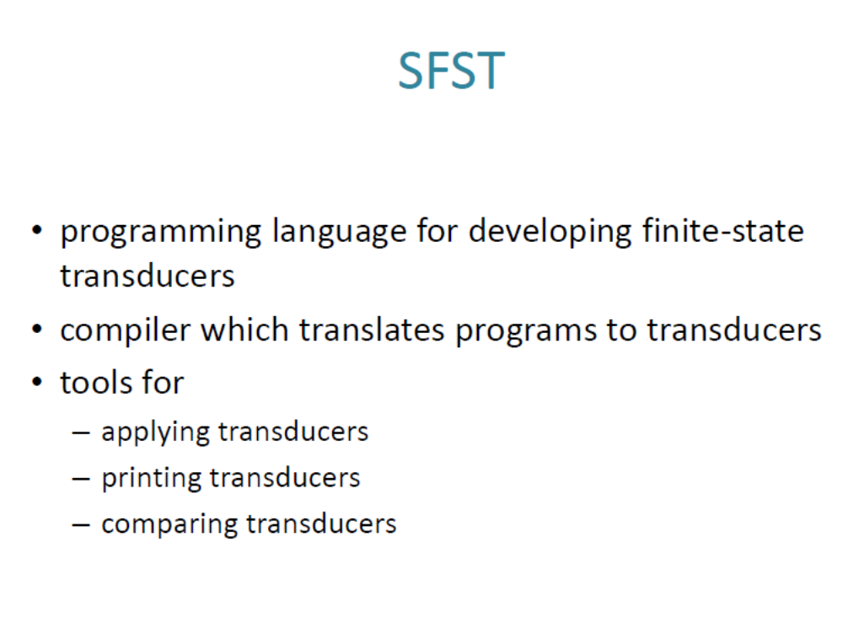
Morphology and FSTs

Slide 152
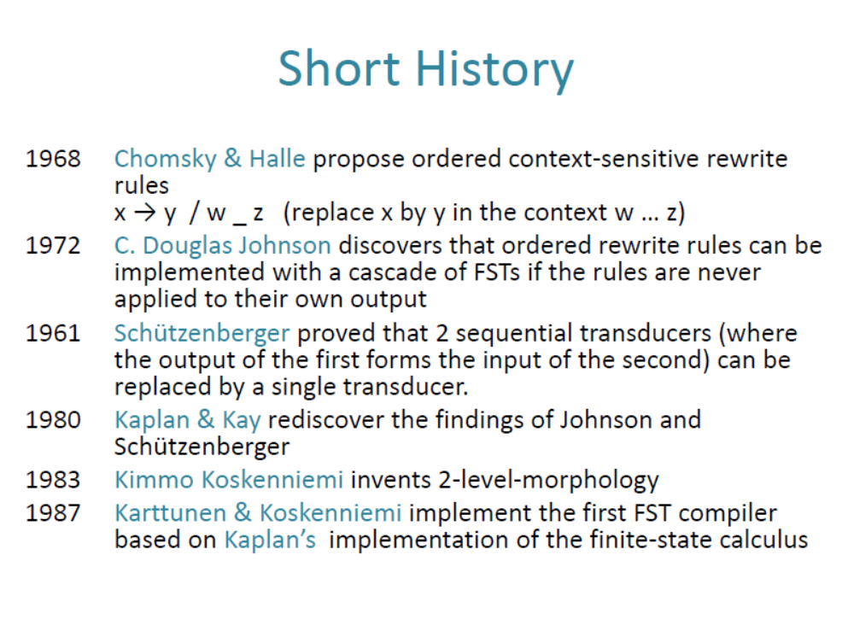
Morphology and FSTs

Slide 153

Morphology and FSTs

